Slide 1





India SDGs Dashboard
Data Manager Guide

Slide 2
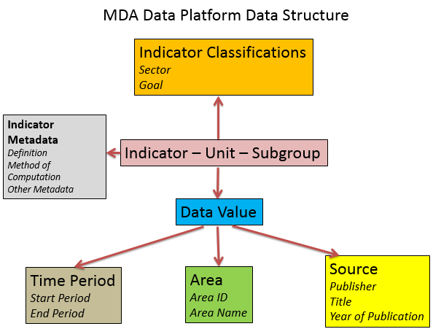
Data Structure

Slide 3
Data Manager
http://itmcloud.org/india-sdg/datamanager

Slide 4
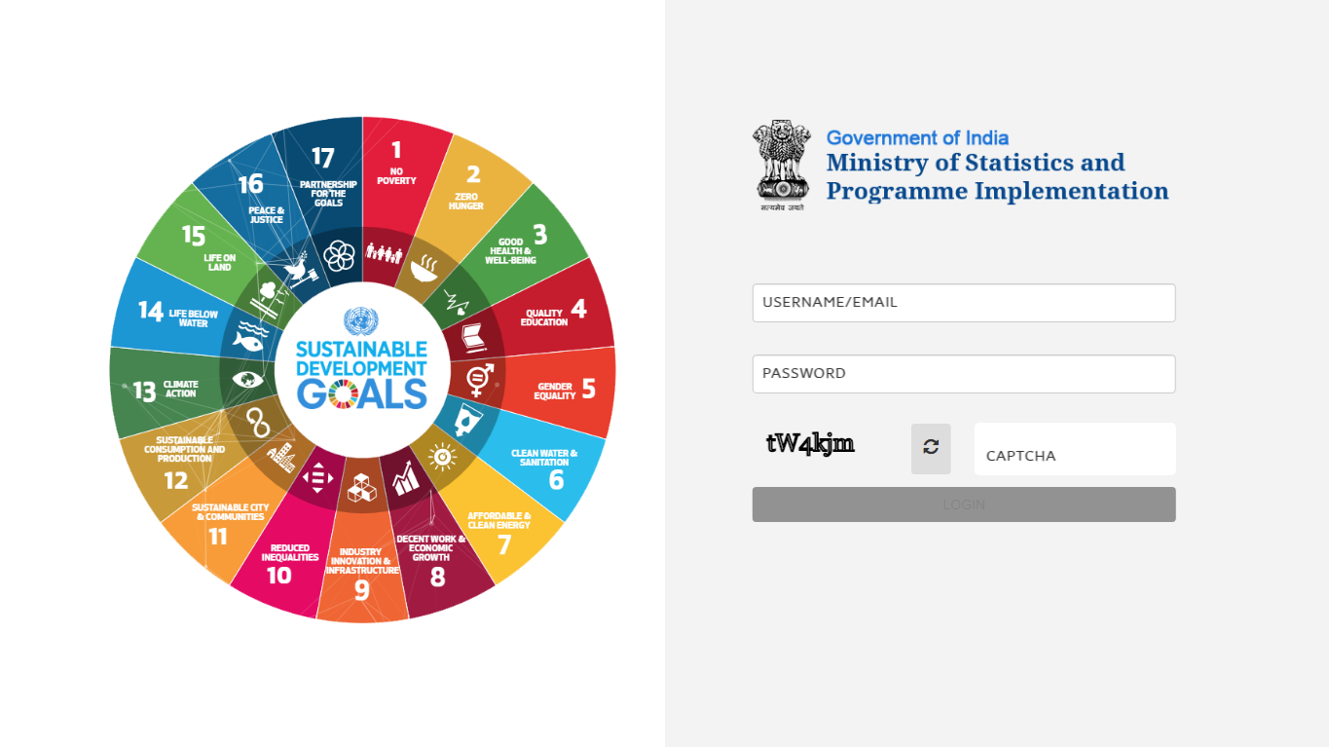
Login Page
Enter user name and Password
Enter captcha
Login as Admin

Slide 5
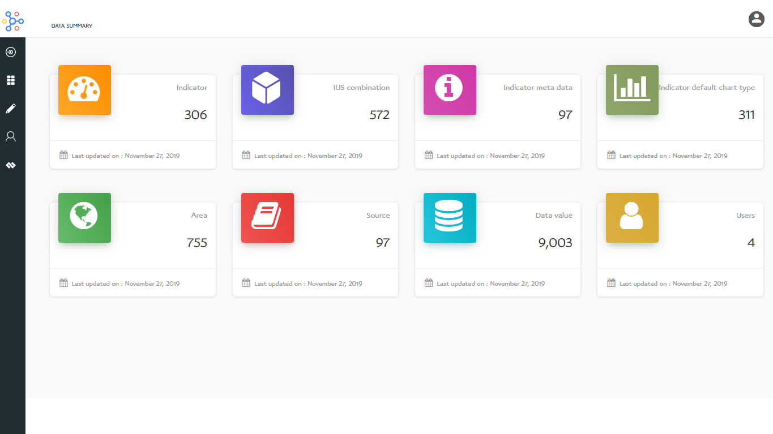
SDGs Dashboard
Data summary

Slide 6
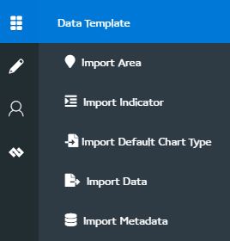
Menu
Click here to download area template and import area

Slide 7
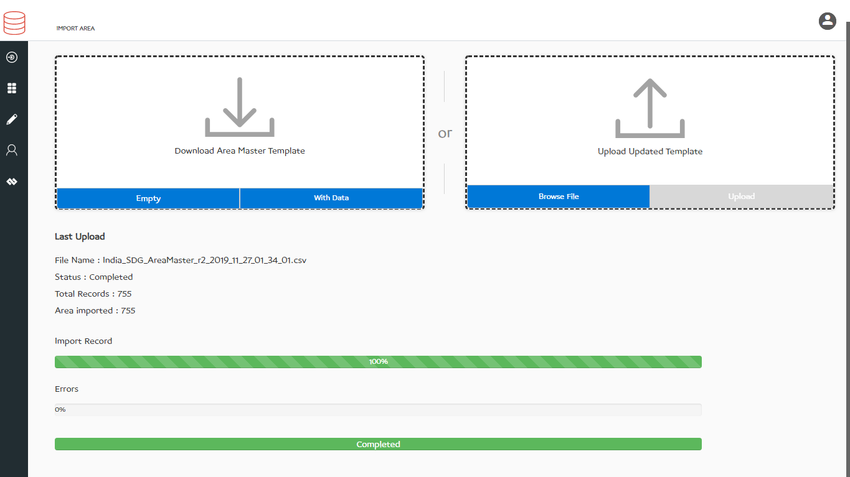
Import Area
Click here to Download Area Template
Click here to Download Area Template with data
Browse Area template with new Areas
Import Area from Template into Database

Slide 8
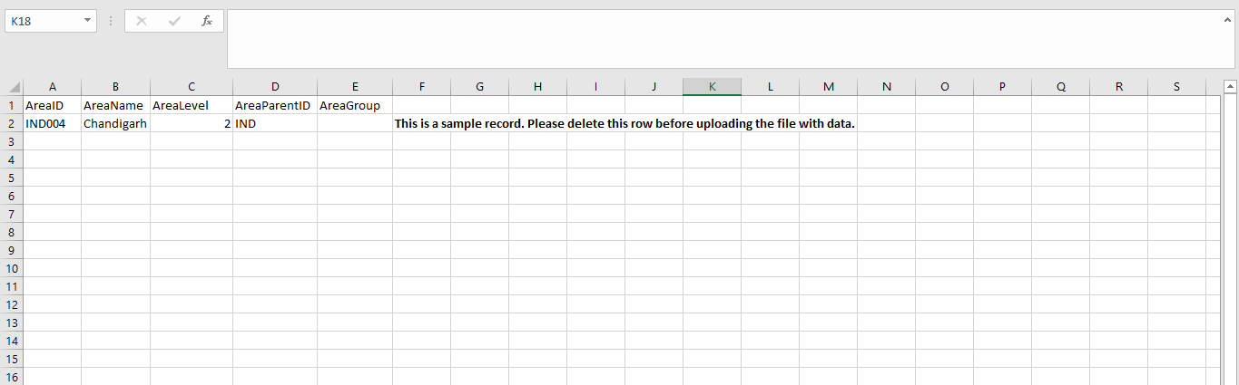
Import Area
AreaID: A unique area identification that associates the area to its map
AreaName: Area Name assigned to an area
AreaLevel: The level number assigned in the area hierarchy
AreaParentID: AreaID of the parent area
AreaGroup: Group of area other than the parent

Slide 9
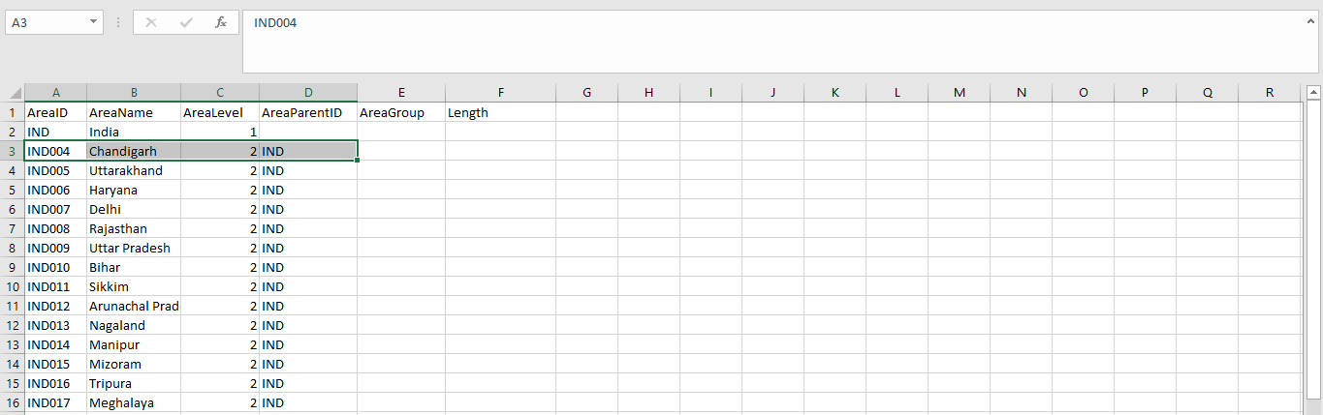
Import Area
Area list from the Database

Slide 10
Menu
Click here to Import Indicator

Slide 11
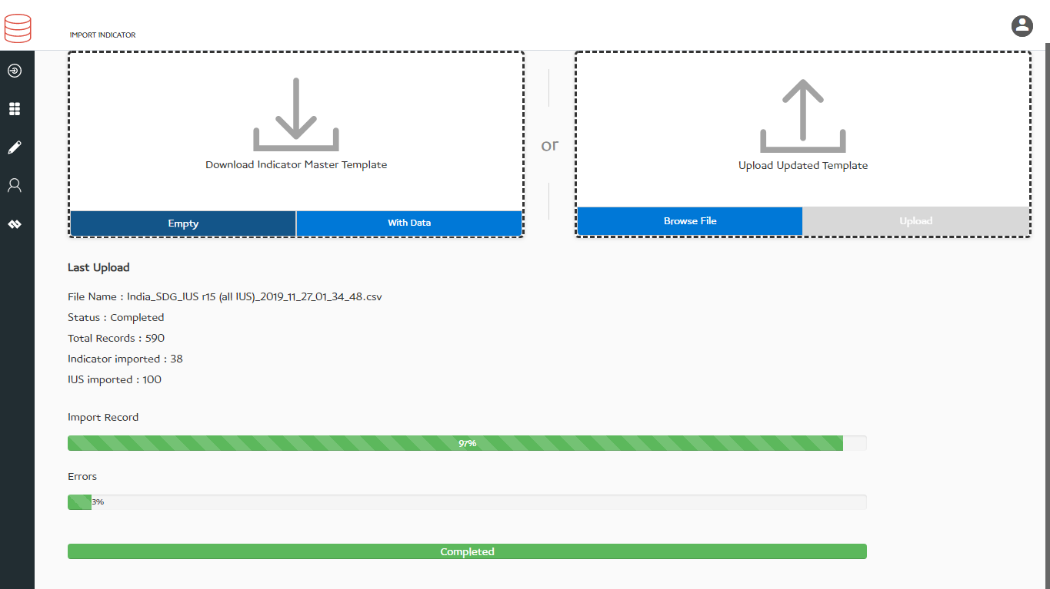
Import Indicator
Click here to Download Indicator Template
Click here to Download All Indicators Template with data
Browse indicator template with new indicators
Import Indicators from Template into Database

Slide 12
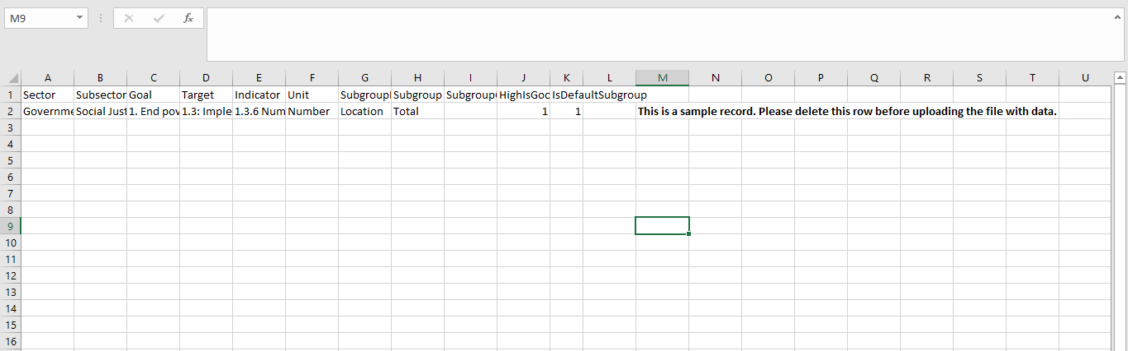
Import Indicator
Sector and Subsector: Indicator classification by Sector and SubSector
Goal and Target: Indicator classification by Goal (optional)
Indicator: Name assigned to an indicator
Unit: Measurement unit of indicator
Subgroup Dimension: Indicator disaggregation category
Subgroup: Indicator disaggregation
Subgroup Order: Indicator disaggregation sequence
HighIsGood: Status to represent good or bad indicator
IsDefaultSubgroup: Mark one of the disaggregation as default

Slide 13
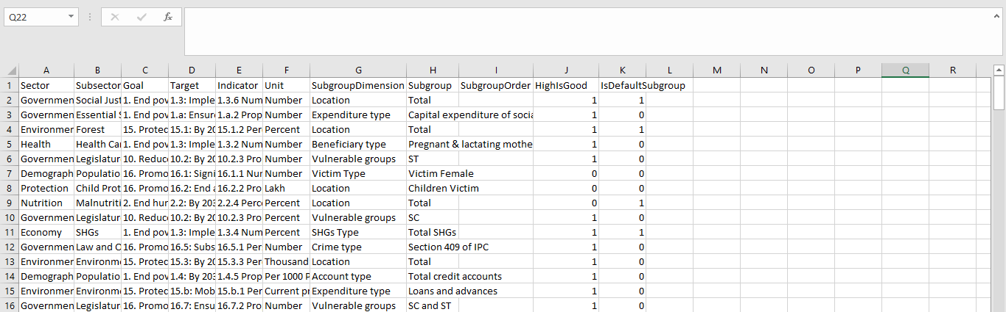
Import Indicator
Indicators list from the Database

Slide 14
Menu
Click here to download chart import template and import chart

Slide 15
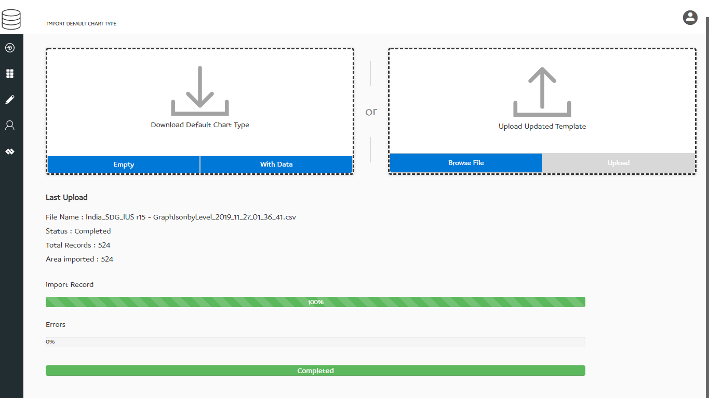
Import Chart Template
Click here to Download Default Chart Template
Click here to Download All Default chart
Browse Default chart template with new Default chart
Import Default chart from Template into Database

Slide 16
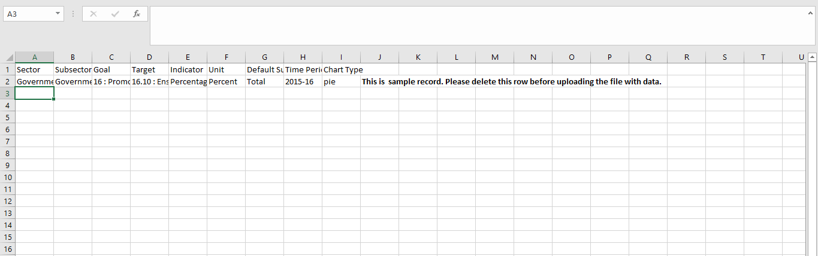
Import Chart Template
Sector and Subsector: Indicator classification by Sector and SubSector
Goal and Target: Indicator classification by Goal (optional)
Indicator: Name assigned to an indicator
Unit: Measurement unit of indicator
Default Subgroup: Indicator disaggregation
Time Period: Data reporting duration (Year, Month, Day)
Chart Type: Set default chart type (line, bar, column, pie, tree)

Slide 17
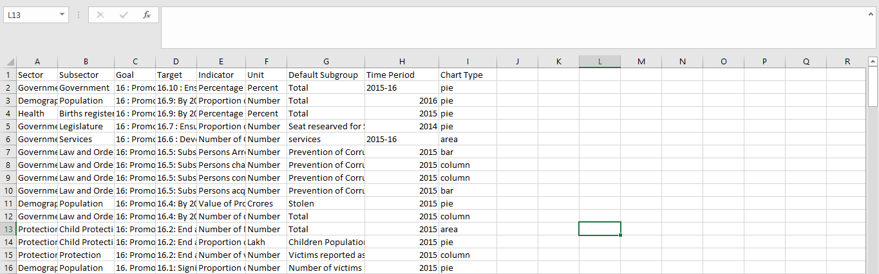
Import Chart Template
Data list from the Database

Slide 18
Menu
Click here to download data import template and import data

Slide 19
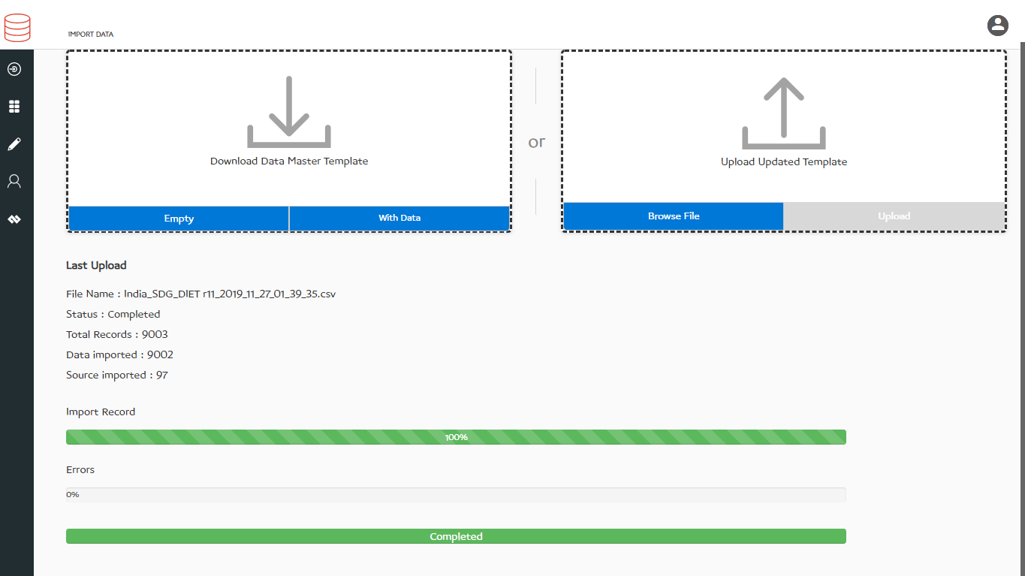
Import Data
Click here to Download Data Template
Click here to Download All Data
Browse Data template with new Data
Import Data from Template into Database

Slide 20
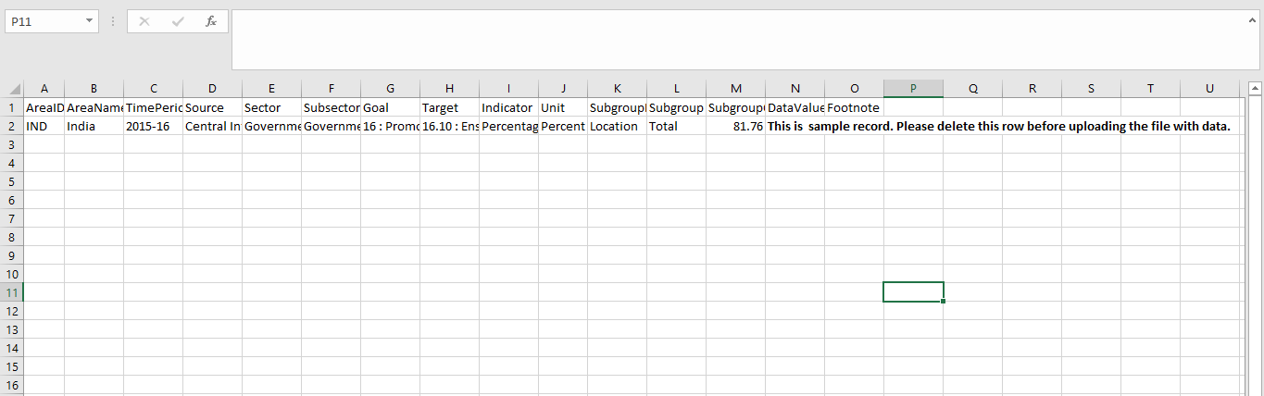
Import Data
Area ID: A unique area identification that associates the area to its map
Area Name: Area Name assigned to a geographical area
Time Period: Data reporting duration (Year, Month, Day)
Source: Data source in which data is reported
Sector and Subsector: Indicator classification by Sector and SubSector
Goal and Target: Indicator classification by Goal (optional)
Indicator: Name assigned to an indicator
Unit: Measurement unit of indicator
Subgroup: Indicator disaggregation
Data value: Actual data
Footnote: Special comment on data value

Slide 21
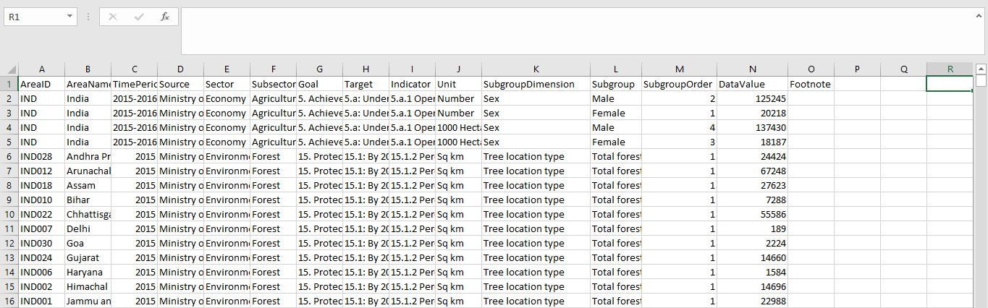
Import Data
Data list from the Database

Slide 22
Menu
Click here to download import metadata template and import metadata

Slide 23
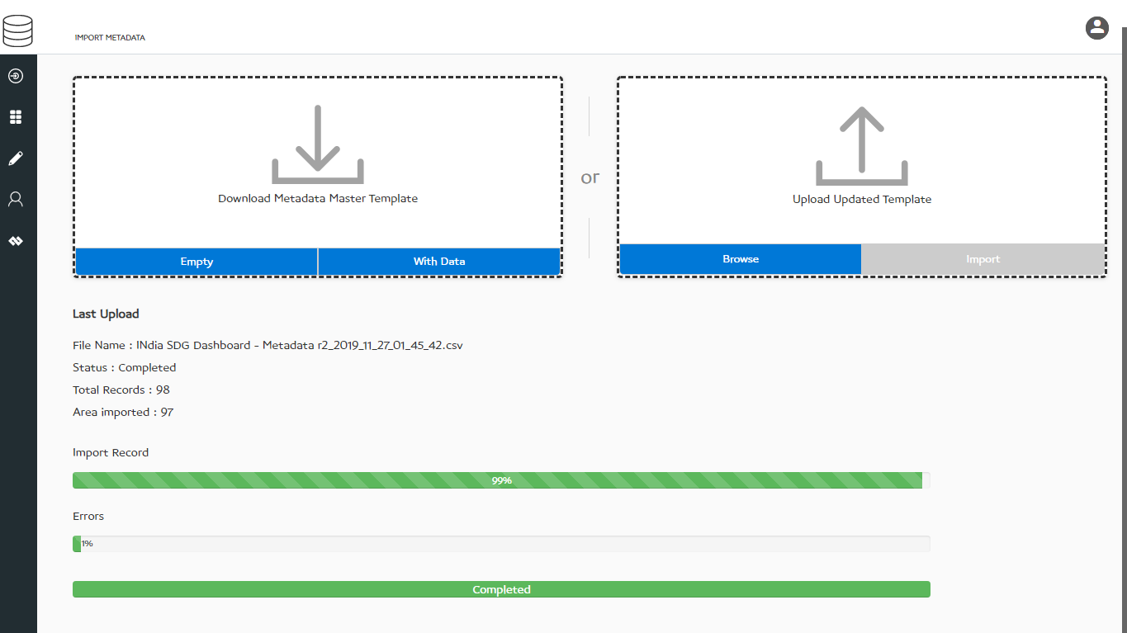
Import Metadata
Click here to Download metadata Template
Click here to Download metadata
Browse metadata template with new Data
Import metadata from Template into Database

Slide 24
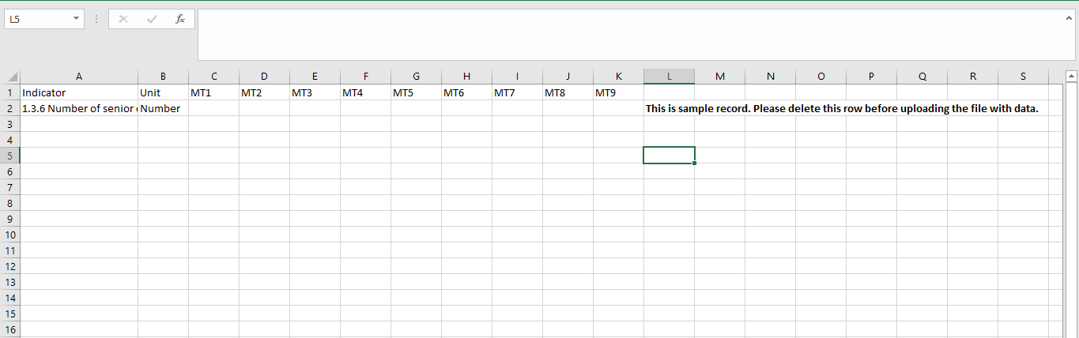
Import Metadata
Indicator: Name assigned to an indicator
Unit: Measurement unit of indicator
MT1: Indicator Definition
MT2: Method of Computation
MT3: Overview
MT4: Comments and Limitations
MT5: Data Collection for Global Monitoring
MT6: Obtaining Data
MT7: Data Availability
MT8: Treatment of Missing Values
MT9: Regional and Global Estimates

Slide 25
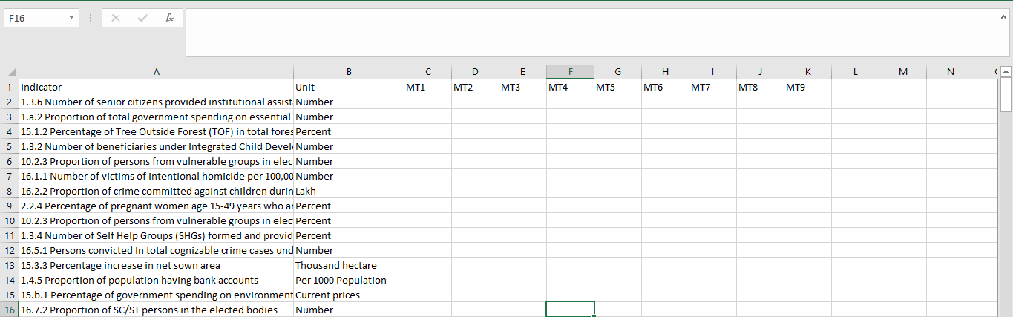
Import Metadata
Data list from the Database

Slide 26
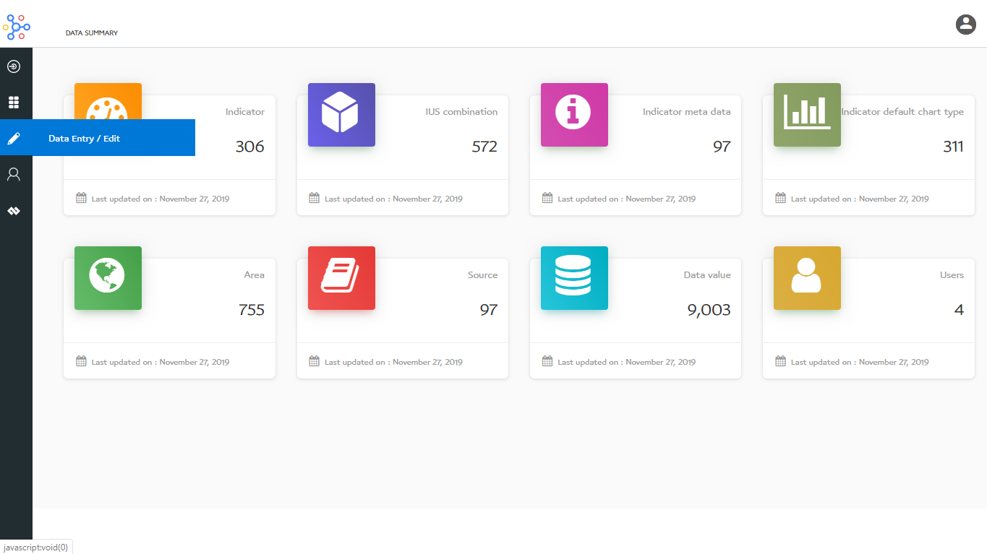
Data Entry / Edit
Click here to Add/Edit Data

Slide 27
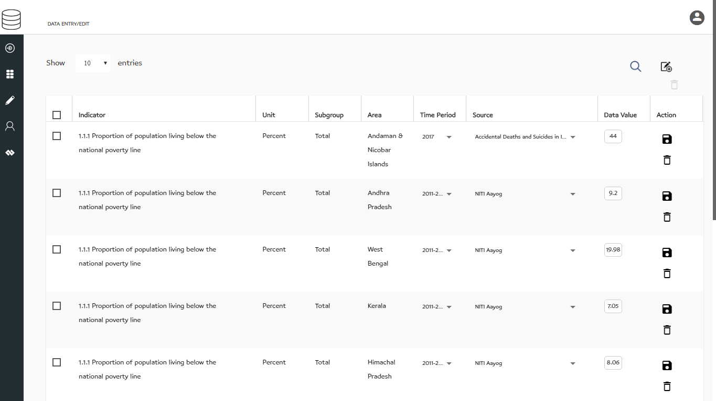
Data Entry / Edit
Filter Data
Click here to delete Entries
Save and delete
Select multiple indicators
Double click on the data value to edit

Slide 28
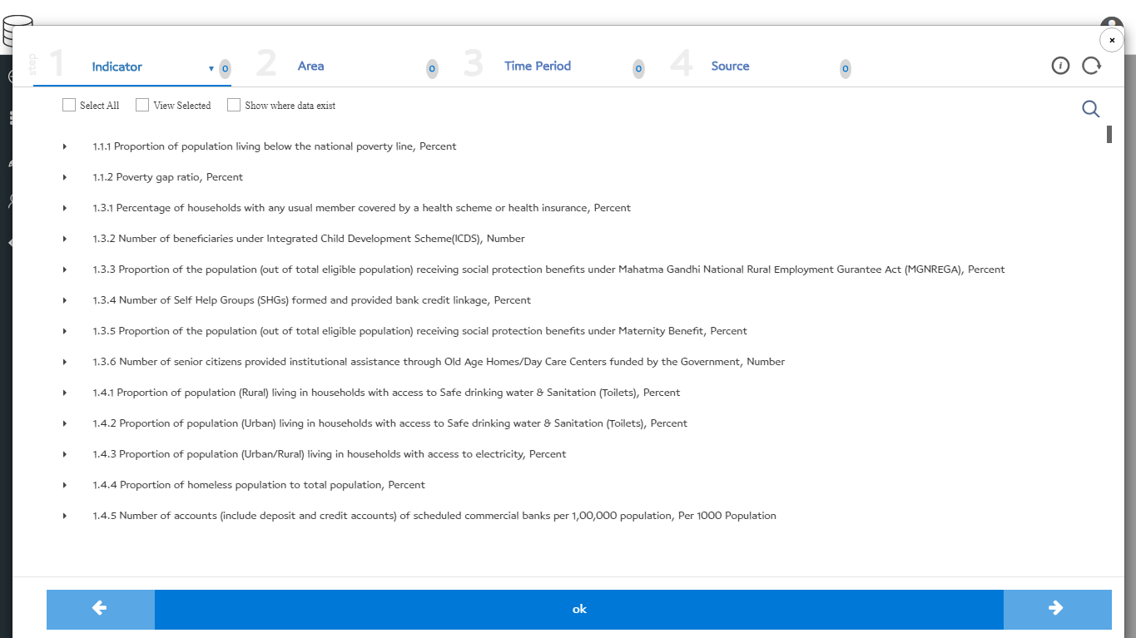
Data Entry / Edit
Select indicator
Select area
Reset Selection
Select source
Select time period
View selected
Add new source
Click here for previous
Click here for next

Slide 29
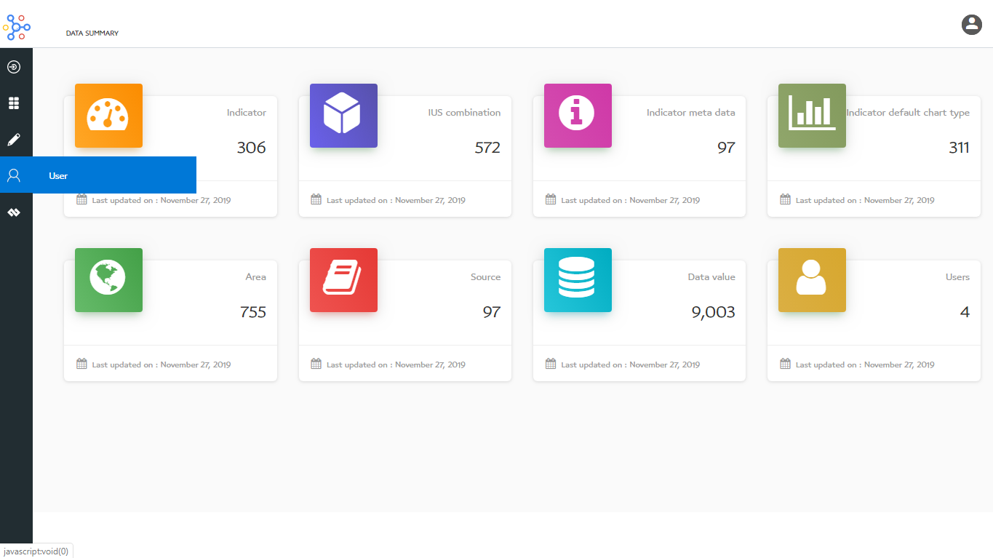
User Management
Click here to User

Slide 30
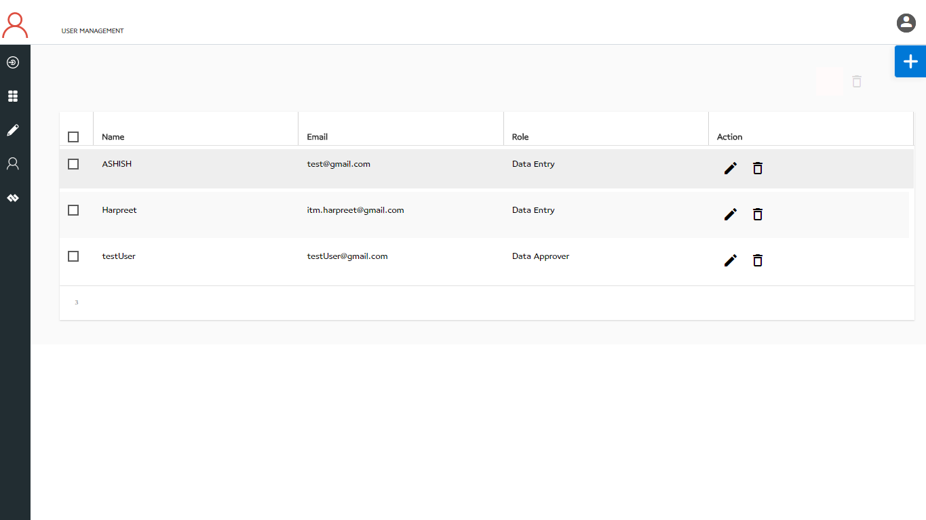
User Management
Add a new user
Delete user
Edit and delete user details

Slide 31
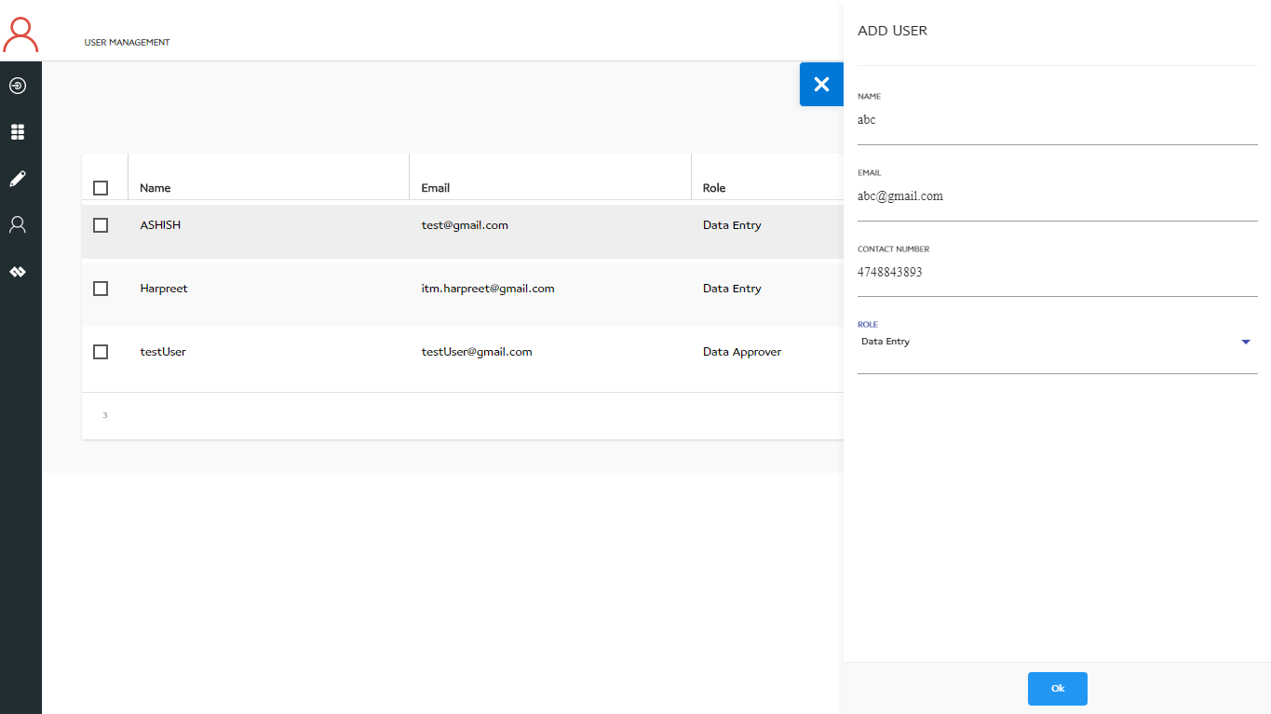
User Management
Click to close form
Add user details
Click to submit user details

Slide 32
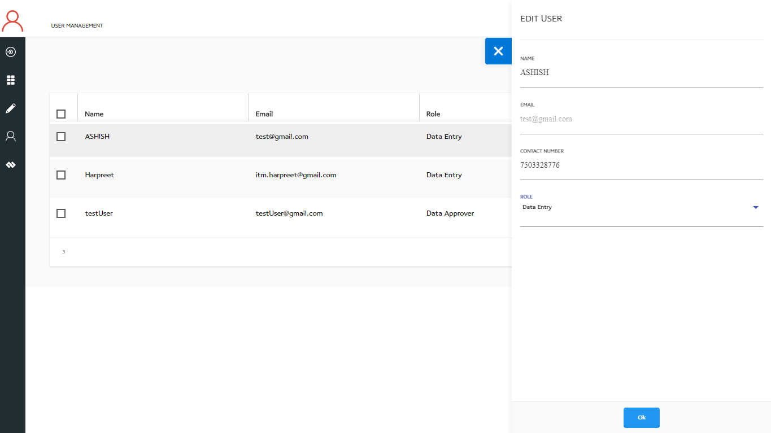
User Management
Click to close form
Update user details
Click to submit user details

Slide 33
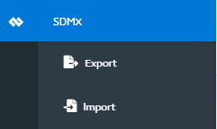
SDMX Menu
Click here to export

Slide 34
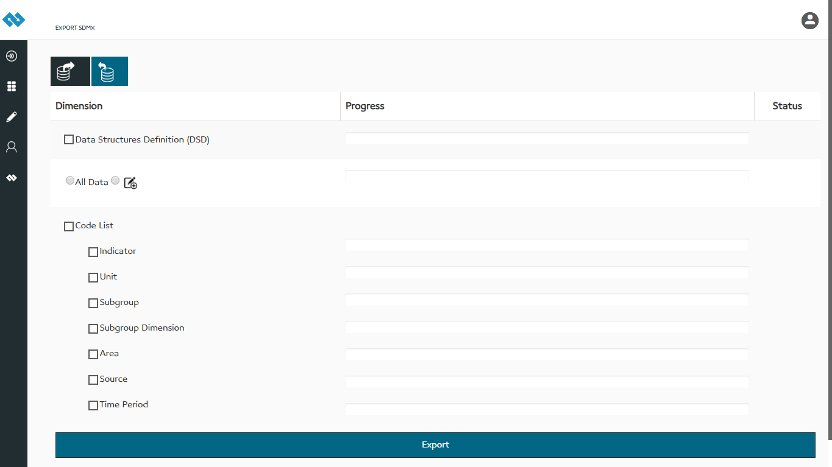
SDMX Export
Click here to open sender and receiver form
Click here to data export filter
Click here to export

Slide 35
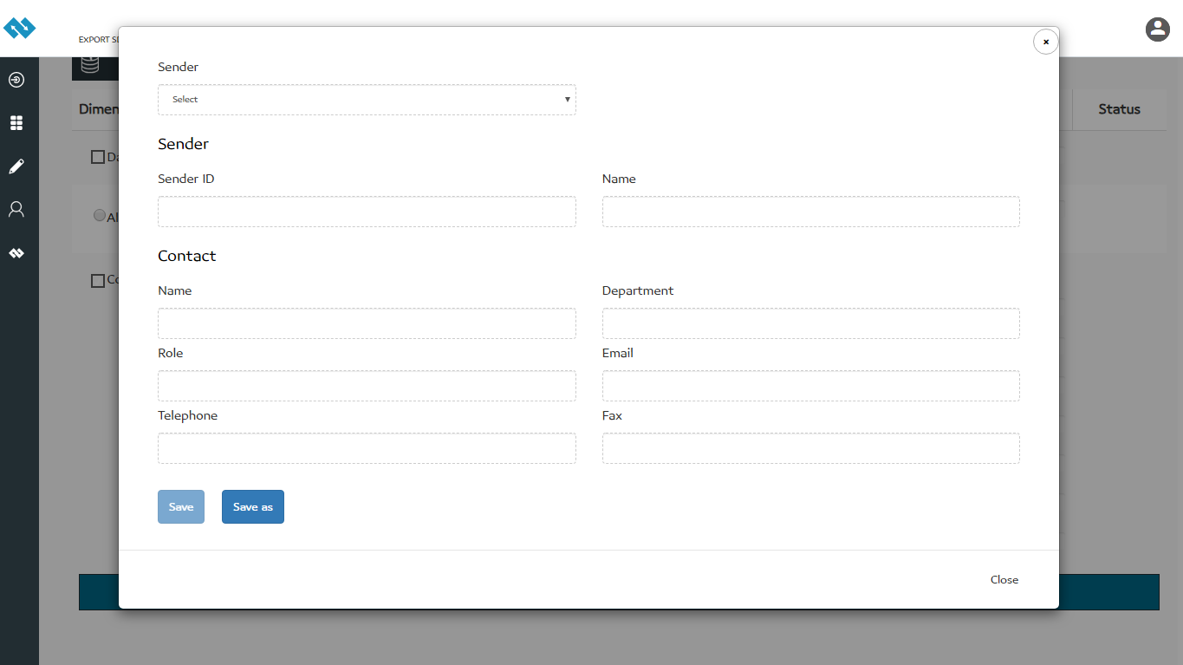
SDMX Export – Sender
Fill sender’s details

Slide 36

SDMX Export – Receiver
Fill receiver’s details

Slide 37
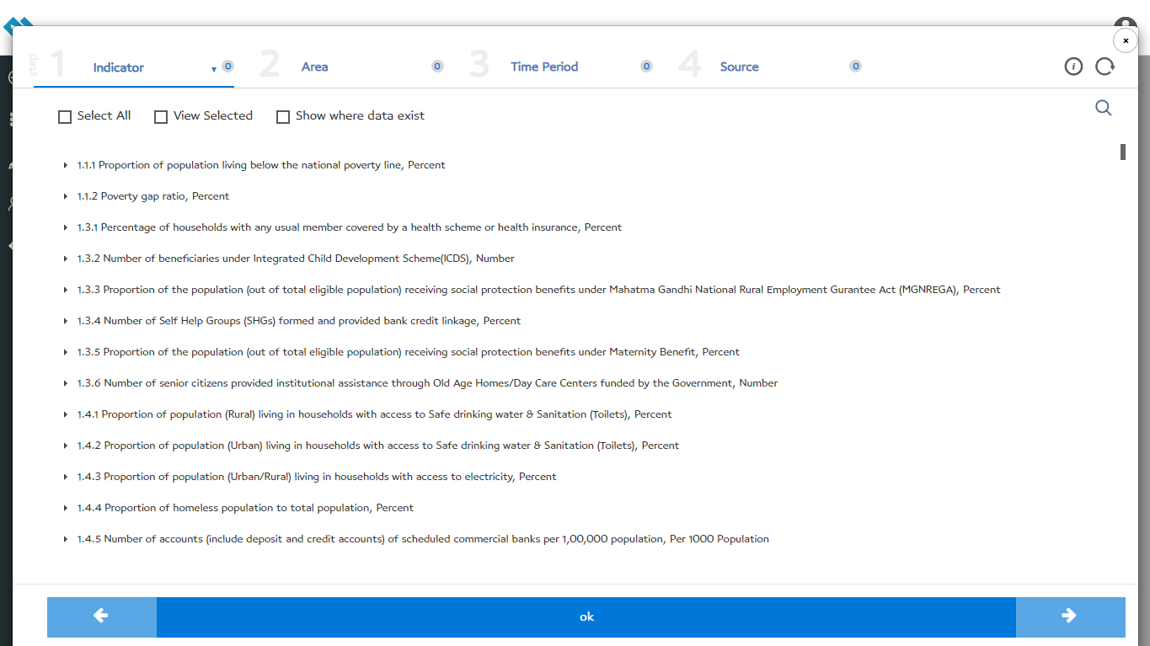
SDMX Export – Data Export Filter
Select indicator
Select area
Reset Selection
Select source
Select time period
View selected
Add new source
Click here for previous
Click here for next

Slide 38
SDMX Menu
Click here to import

Slide 39
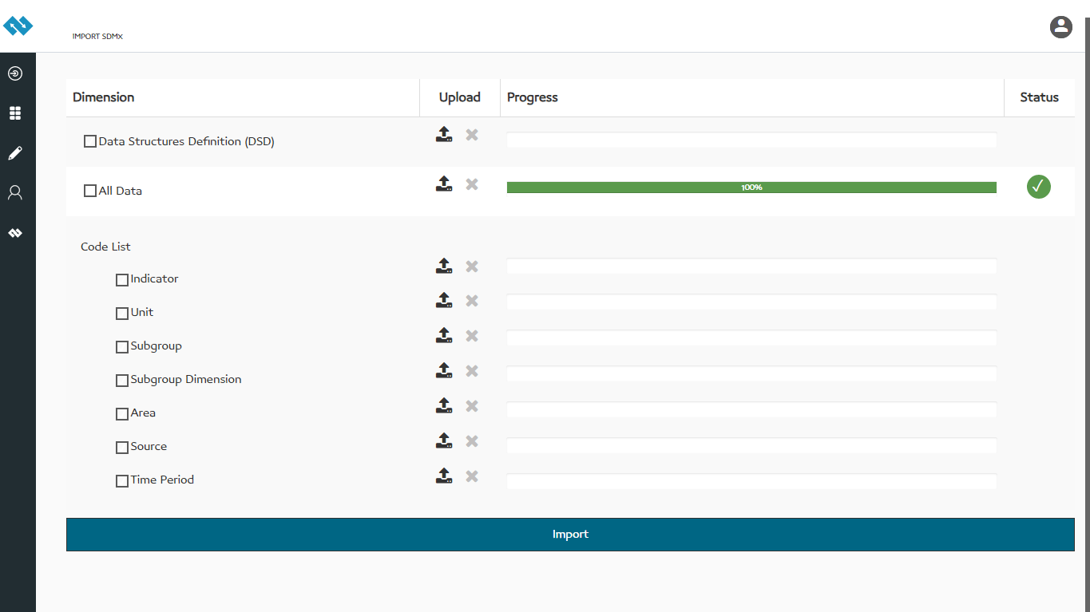
SDMX Import
Click here to import
Click here to import

Slide 40


